Slide 1




DISPLAY BOOKSHELVES
PEPPERFRY.com

Slide 2
Hackathon PROJECT
GYANRAJ HANSDAH | 2361781

Slide 3





Objectives
Bookshelves
Display top 3 Bookshelves below Rs.15,000
Luxury Menu
Display all the sub-menu items under Luxury.
Study chairs
Display 3 Study chairs with highest Customer Ratings
Gift cards
Display the error message of invalid email

Slide 4






Phases of project
Test cases
POM
TestNG
Maven
Jenkins
Results

Slide 5
Tools , Software, Website Used
Website : https://www.pepperfry.com
Selenium : Portable Framework for testing web applications and automating the process.
Java : High level programming language.
Eclipse : Integrated Development environment for various Programming Languages.
TestNG : Open-source testing framework.
Maven : Software And Project Management Tool.
POM : Object Repository design pattern.
Jenkins : An open-source automation server for continuous integration.

Slide 6
Work done
The code is written in JAVA language and then it is further automated using selenium.
Page Object Model(POM) is used to reduce the code duplication for various instances.
Input data is taken from excel file using Apache POI.
Jenkins repositories are also used, to make it easy to make changes to various versions of code and to modularize it; also, to help with continuous integration.

Slide 7
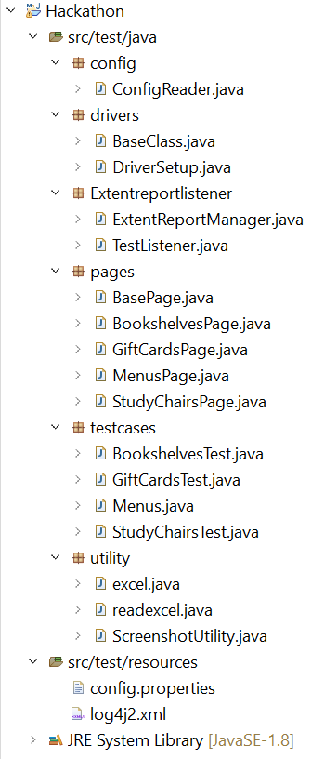
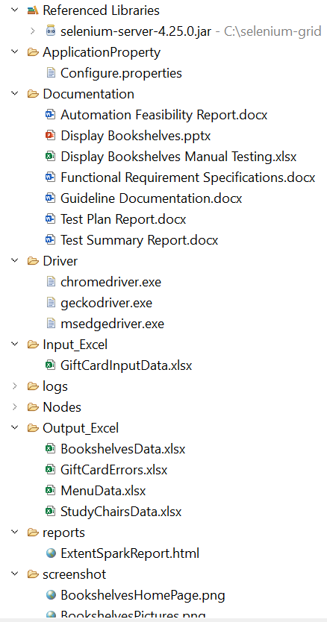
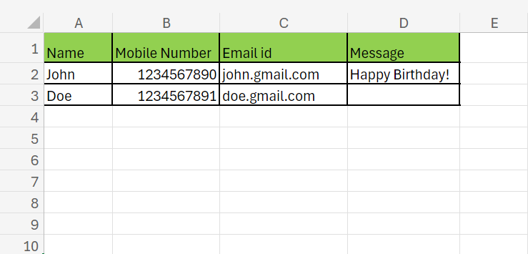
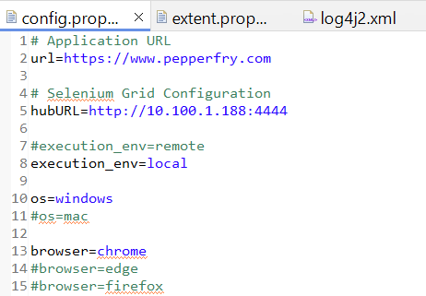
Framework and input excel Sheet

Slide 8
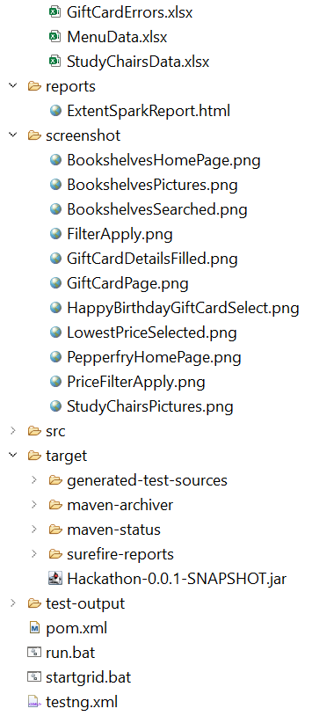
Framework and input excel Sheet

Slide 9
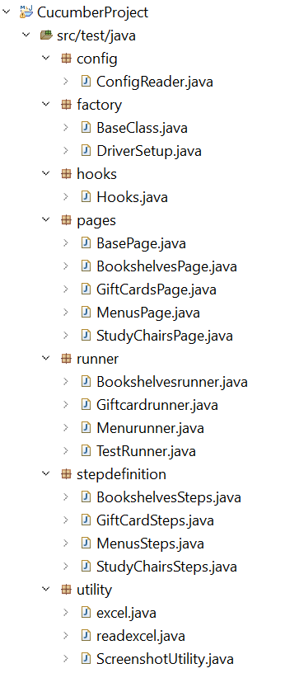
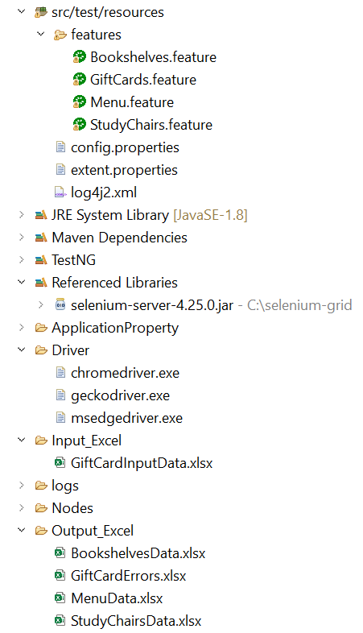
Framework and input excel Sheet

Slide 10
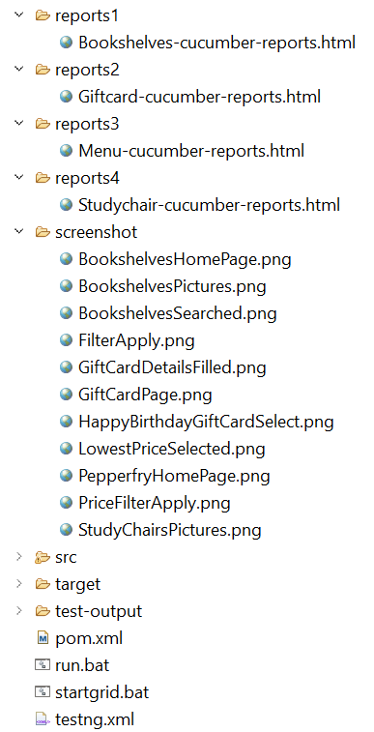
Framework and input excel Sheet

Slide 11
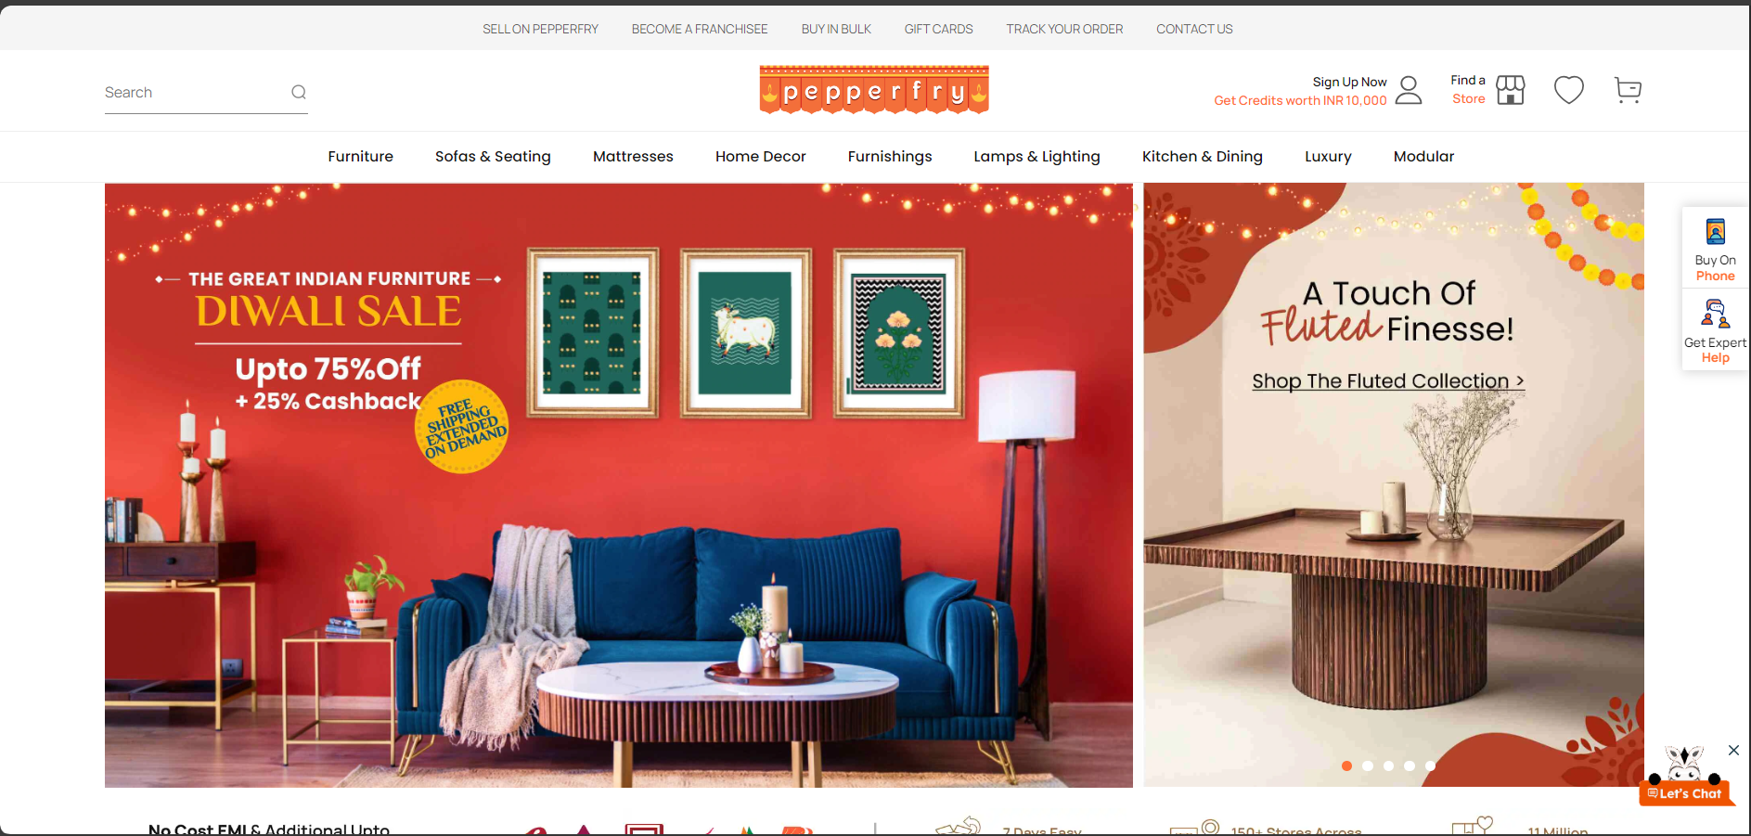
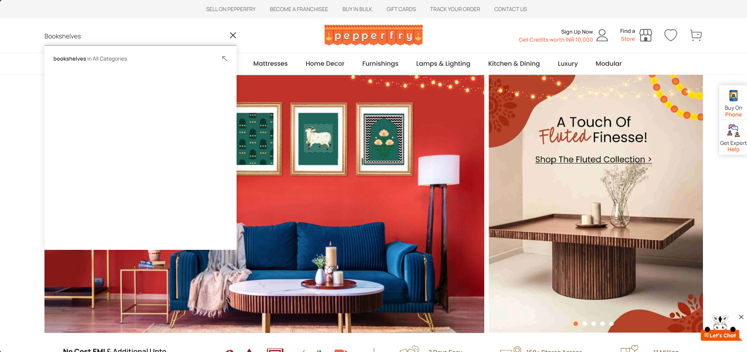
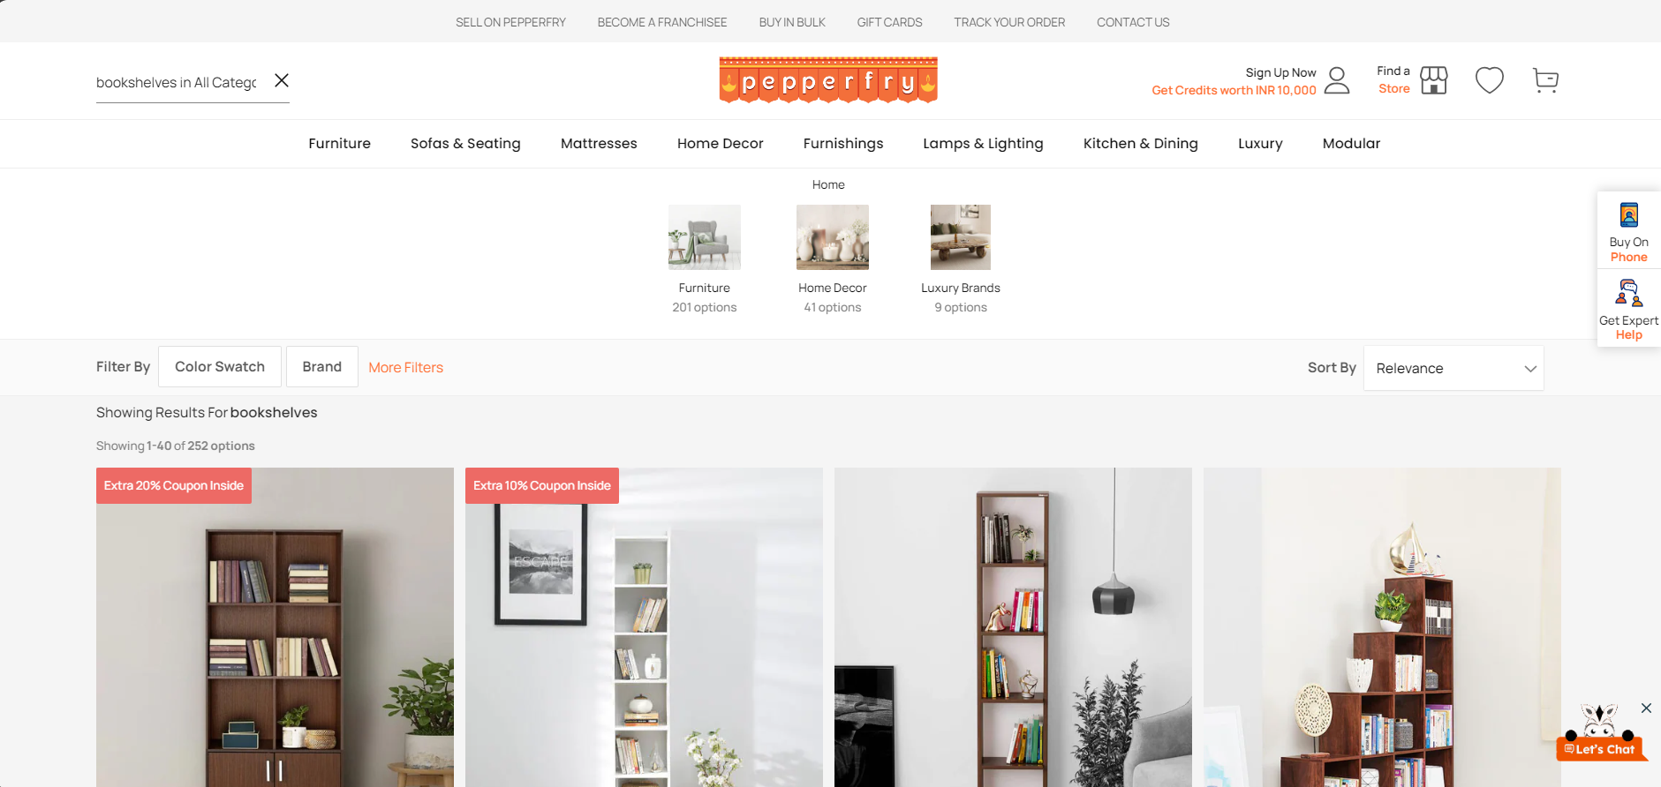
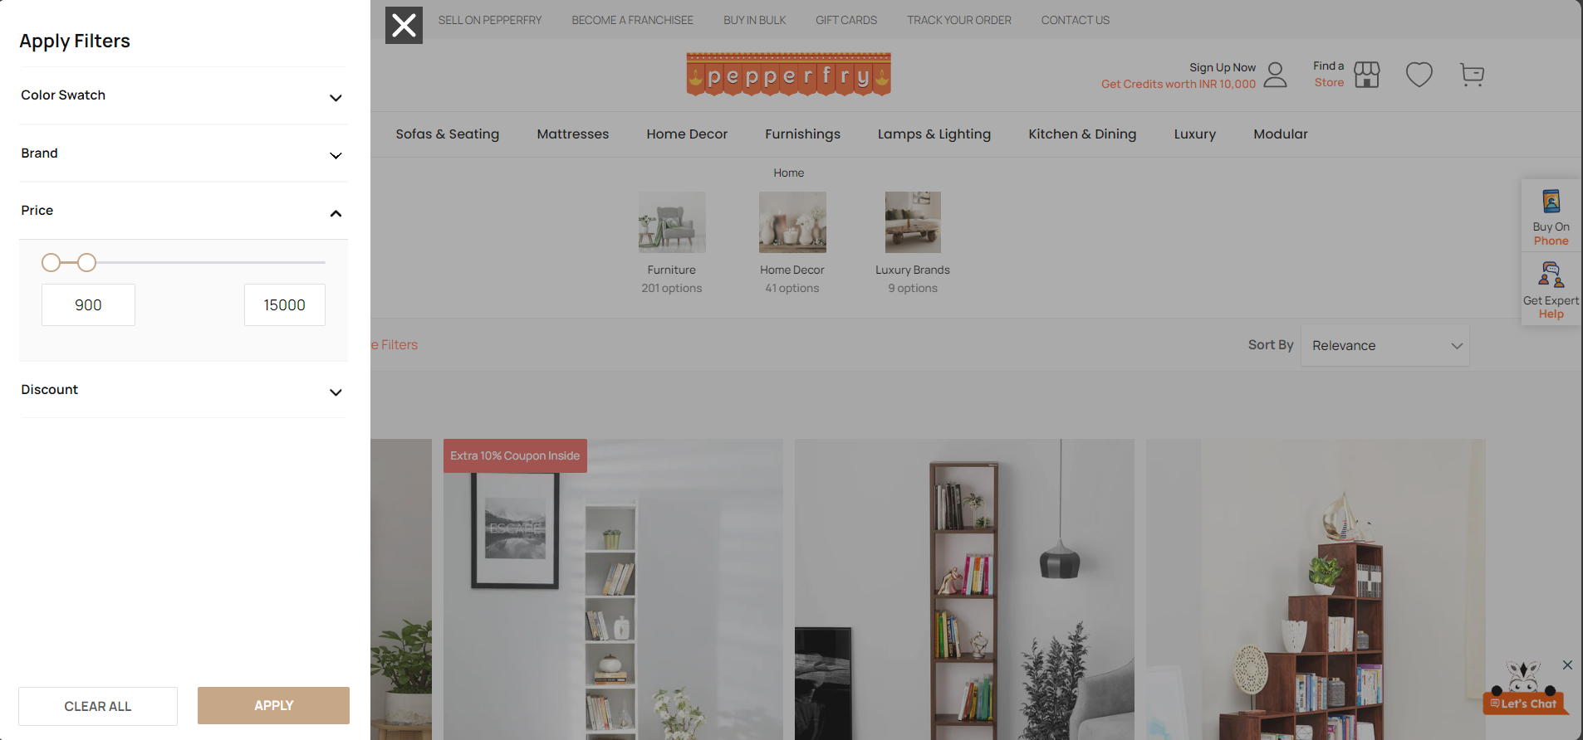
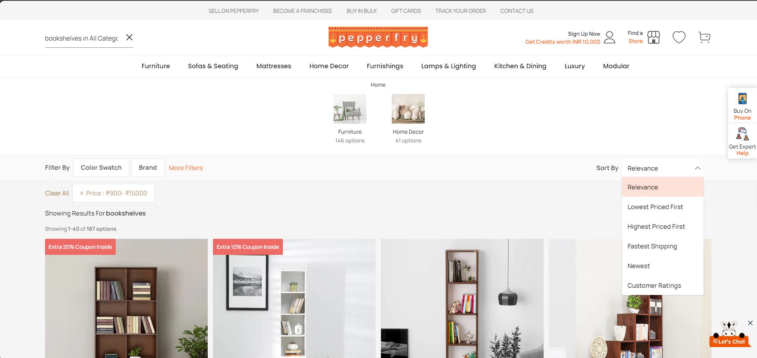
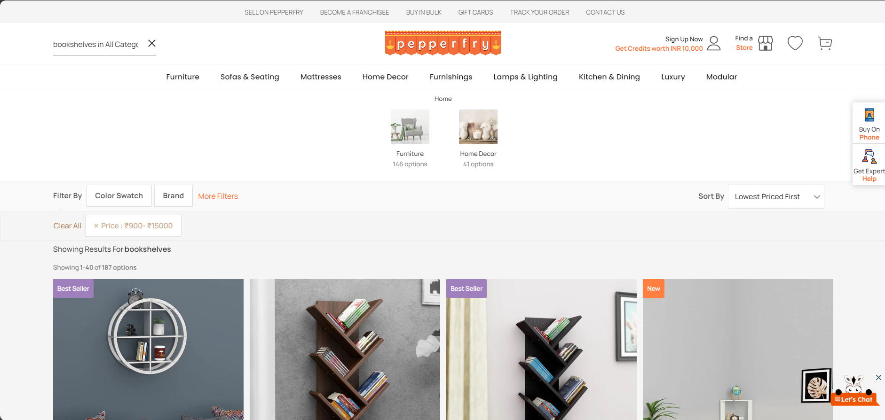
Screenshots

Slide 12
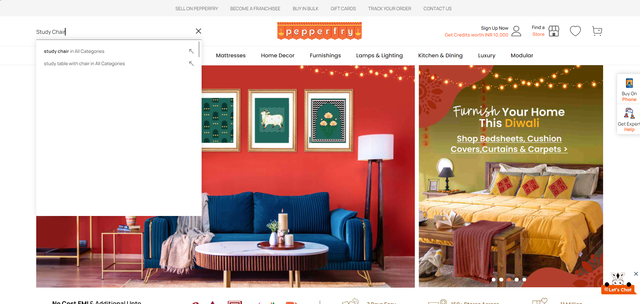
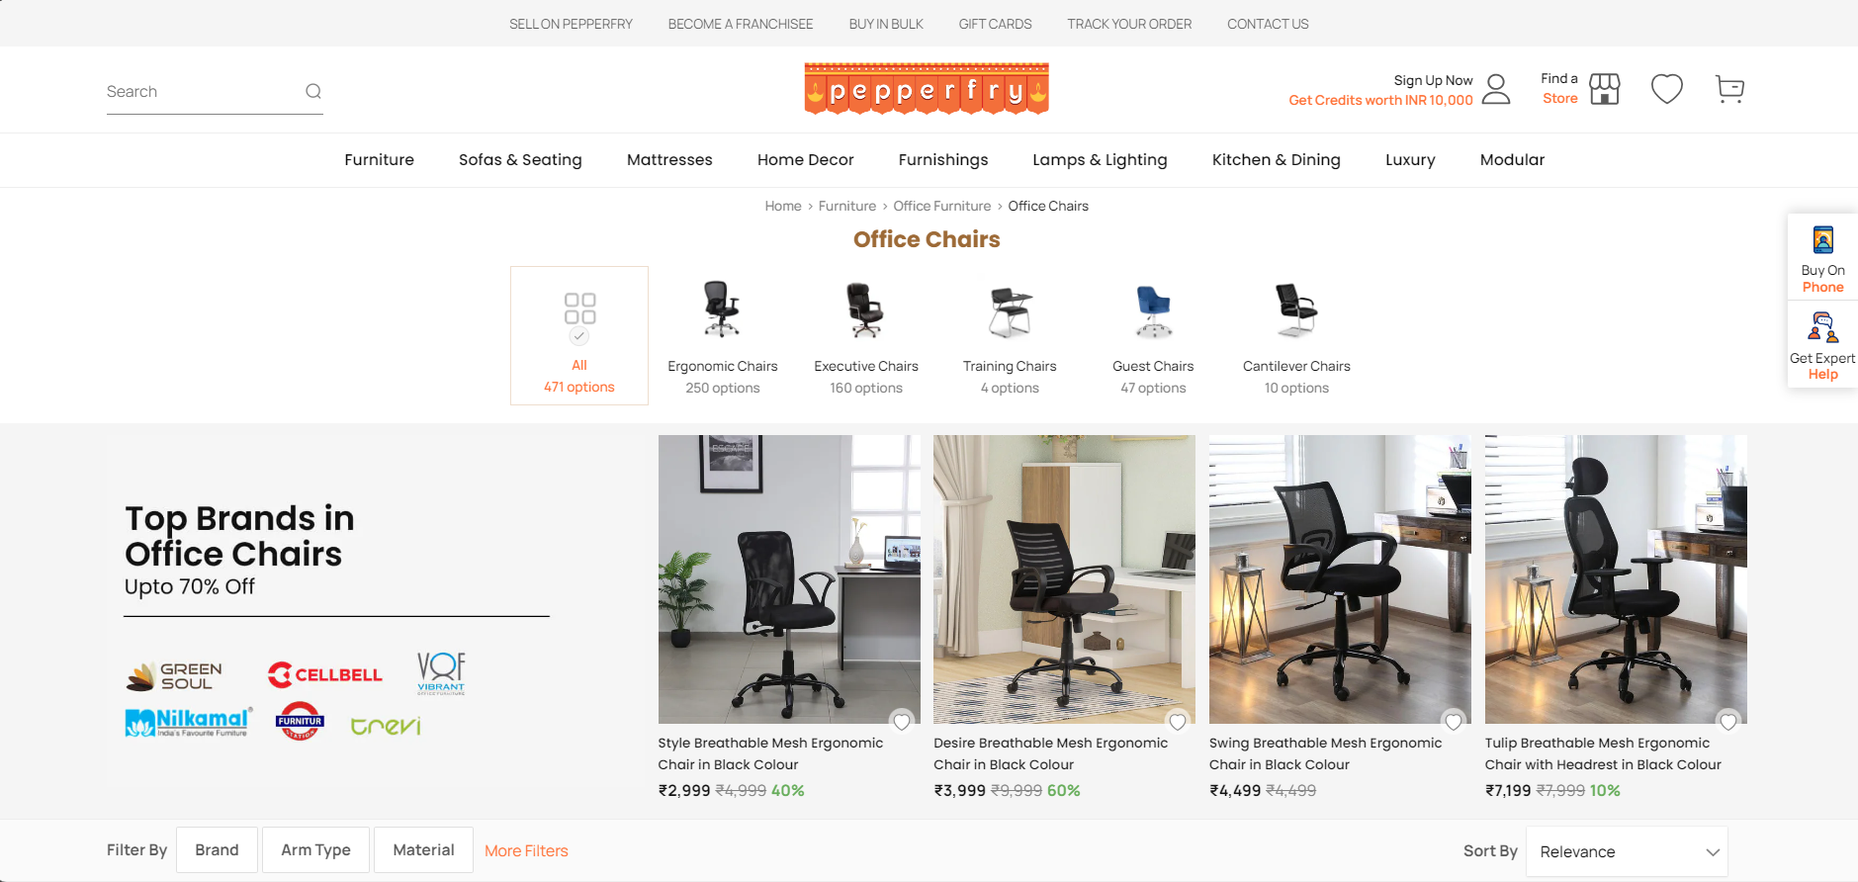
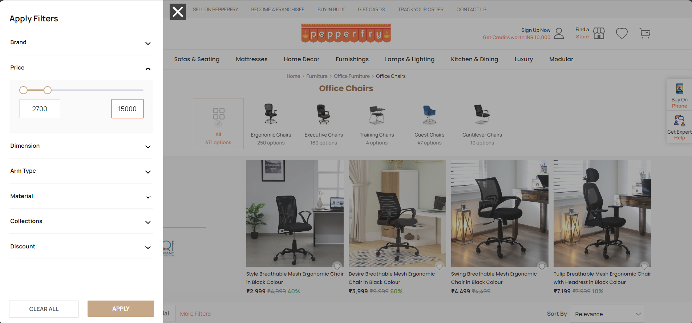
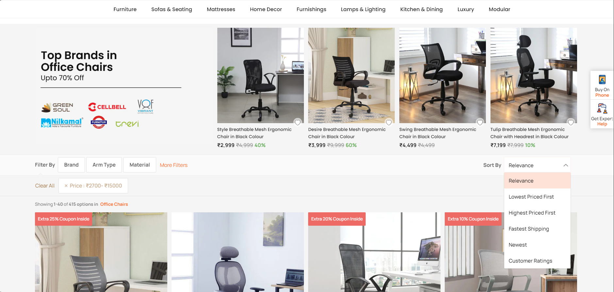
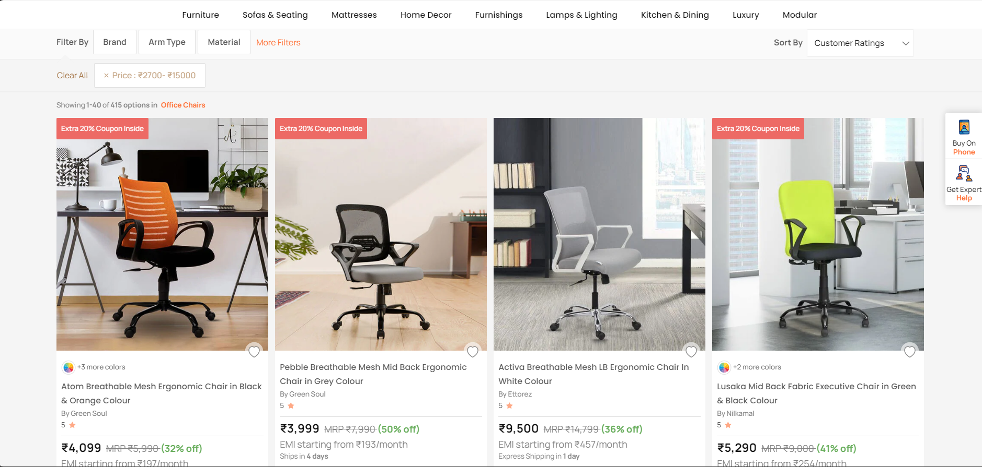
Screenshots

Slide 13
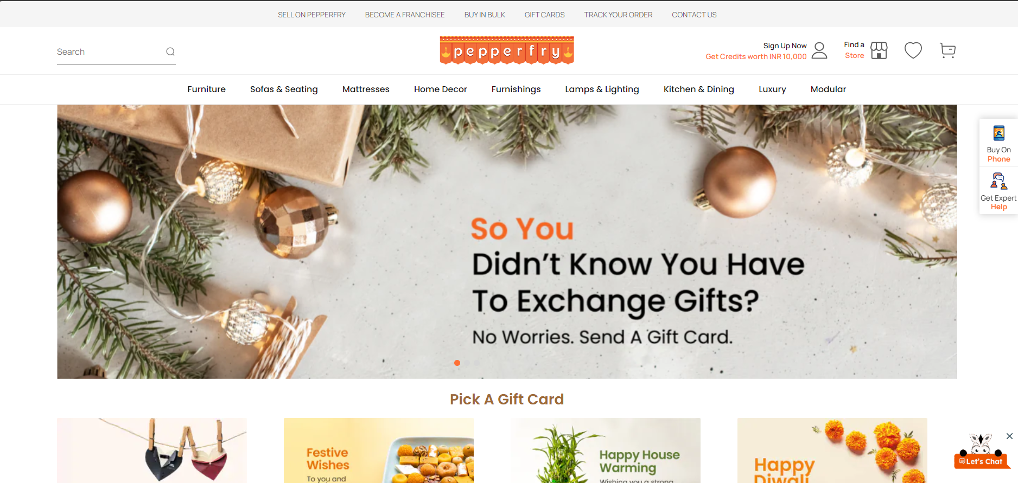
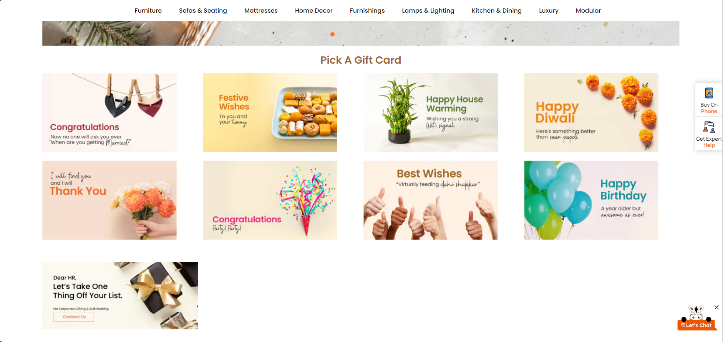
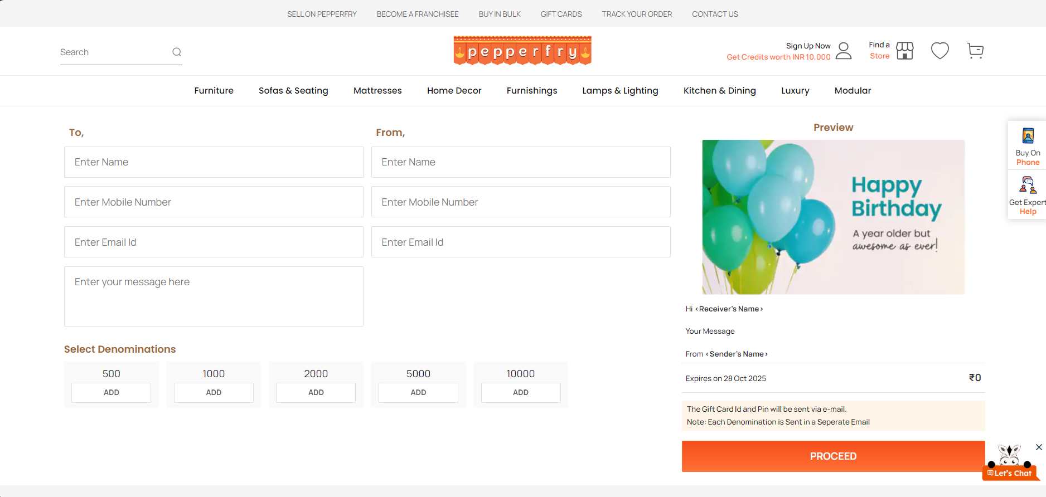
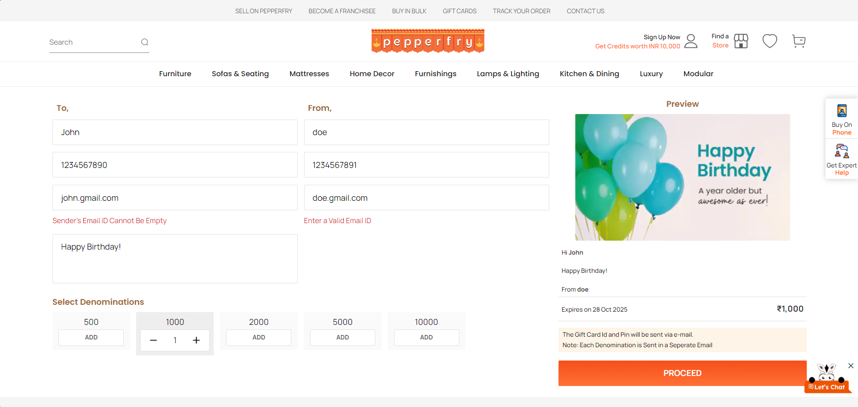
Screenshots

Slide 14
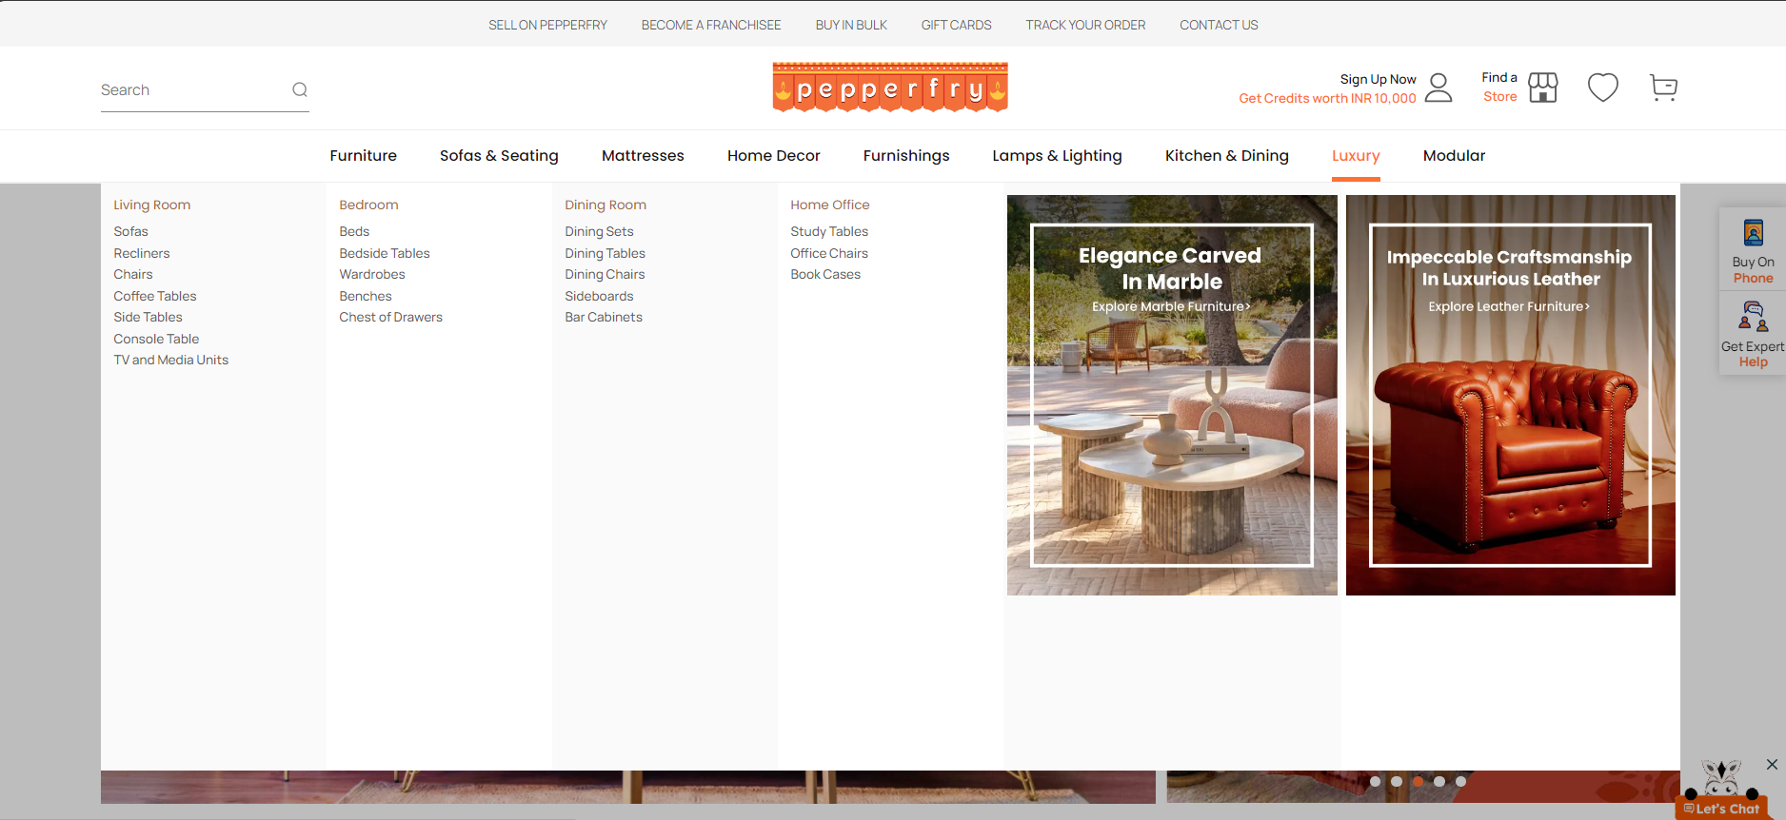
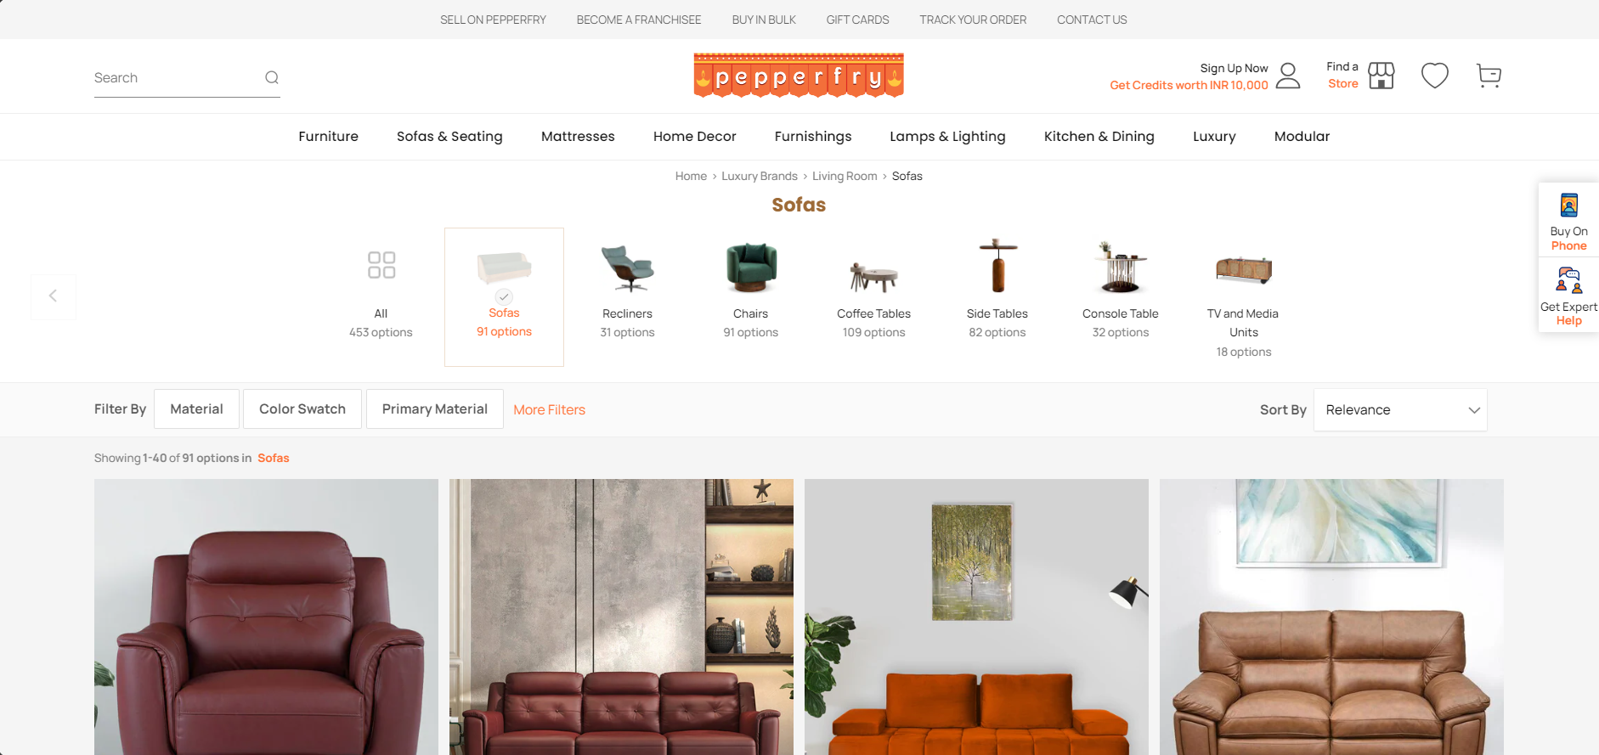
Screenshots

Slide 15
Thank You

